Slide 1

Evolution Oil Tools Inc. (EOT) was formed in January of 2011
Headquarters in Calgary, Alberta, Canada
Manufacturing, Assembly and Testing shops are in Calgary, Alberta and Victoria, Texas
Sales & Distribution locations in Lloydminster, Alberta and Odessa, Texas
We offer products / services from 4 different product groups:
Artificial Lift Systems
Flow Control
Packers / Completions
Coatings
We currently hold ten (10) U.S. or Canadian product patents
The majority of Evolution’s own product designs and intellectual property have been used in the industry for over a decade
Our staff combined offers over 100 years of experience in the industry
Take Advantage of our experience
“Knowledgeable personnel providing and developing quality products and timely
Solutions to the Oil & Gas Industry”
www.eotools.com

Slide 2
TUBING ROTATORS
CTR Tubing Rotator
E-Plus Tubing Rotator
www.eotools.com

Slide 3
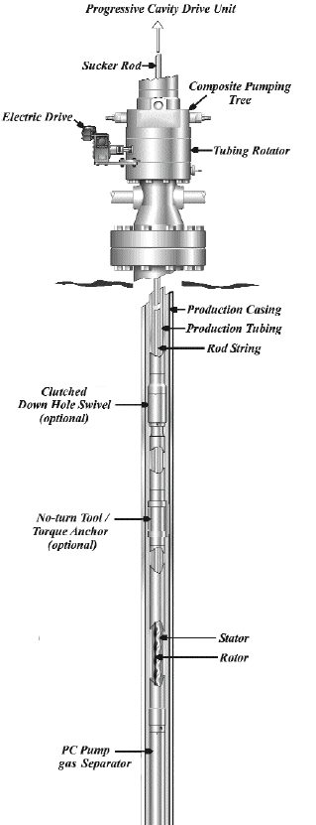
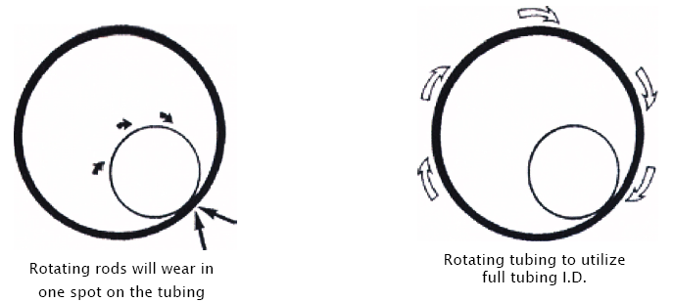
Tubing Rotators
The tubing in a rod pumped well represents the second largest investment in the well. Every day, every stroke on the pumping unit can cause wear in the tubing. On every stroke the rods move up and down in the tubing. The rods will always tend to lie on the downside of the tubing so on every stroke of the pumping unit the rods are wearing a path into the metal of the tubing, a path that will become a hole in the tubing.
In a typical pumping well running at 10 strokes per minute, the rods will move against the tubing 14.400 times everyday. This wear will eventually cause a tubing failure. You are paying for a full 360°of tubing, yet because of the way the rods act in the tubing, you are only getting the use of 20° o f the tubing.
Rod rotators will reduce wear on the rods. Unfortunately the rods still lie in the tubing and wear away at the tubing.
There is a system that will give you the full use of the tubing you paid for. The Evolution Tubing Rotators use a very simple idea. Rotate the tubing. By rotating the tubing, the wear from the rod is equally distributed over the entire area of the tubing. The tubing will last longer and stay in the well where you want it to be.

Slide 4
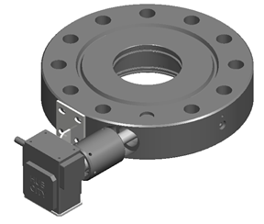
Tubing Rotators
After the installation, The CTR Tubing Rotator can be operated
through one of three methods:
Manually Driven
Allows the operator to rotate the tubing on a daily basis.
Simply crank on the handle to rotate the tubing.
Mechanically Driven
Connected to the walking beam of the pump jack.
Drive transmission through cable, ratchet, or manual.
Electric Motor Driven
Connects to on site power (3 phase), (single phase) or 12 volt.
Uses high ratio speed reducer.
All options are provided with a shear mechanism to prevent over
torquing of the tubing string.
Mechanical Bracket Assembly
Manual Bracket Assembly
Electric Motor & Bracket Assembly

Slide 5
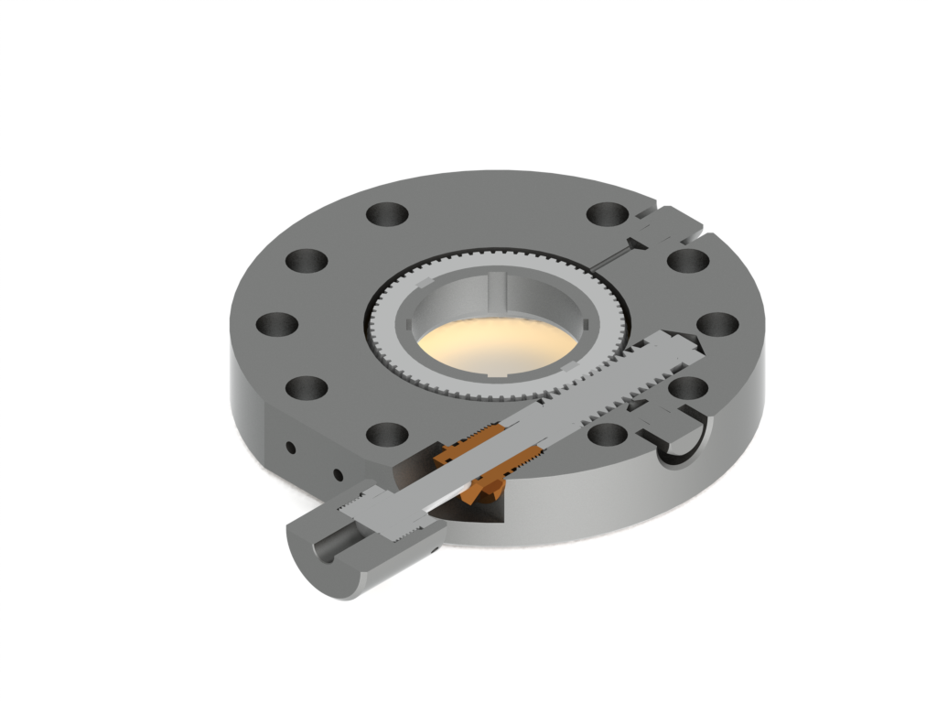
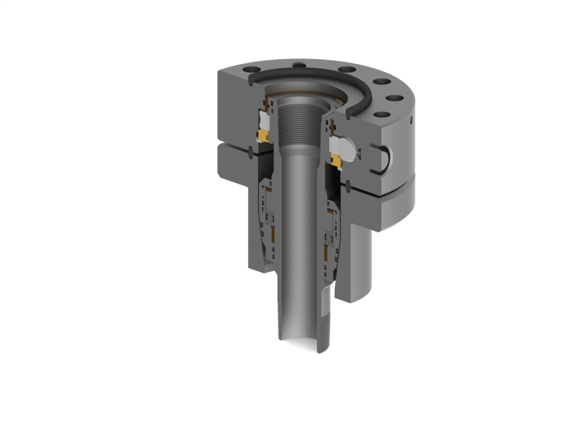
E-Plus Tubing Rotator
Complies with API 6A bolting requirement
Adds only 4.50” to Wellhead height
Simple installation and removal
Can adapt to an API wellhead in its range
Can adapt to an API wellhead in its range
Lower Ring Gasket can be pressure tested
Virtually maintenance free
Can be adapted for thermal applications up to 21°C
Abnormal pump wear eliminated
Sand build-up in pump barrel eliminated
Enhances corrosion inhibitors
Prolongs Tubing life 6-10 times
Paraffin build-up eliminated (in most cases)
Rod hang-up eliminated (in most cases)
Replaces the conventional hanger
Maintains well control while stripping BOP’s
Can utilize manual, mechanical (pump jack) or electric (110V, 460V or 12 volt)
A-Plus Tubing Hanger

Slide 6
Customer Testimonials
“Evolution’s tools are very user friendly and easy to install. Their CRTA Anchors set and release
well even in deviations. Evolution’s Rotators have been installed on our wells and we have never
had any issues with them to date. Most have been on for more than a year and are running fine.”
Petro Canada / Southern Alberta Region
“I believe the Evolution line of Tubing Rotators, are
The most cost effective than that of the competition.
Not having serviced one yet makes me believe the
durability of the product is far superior to any other
models I have come across.”
CE Franklin Ltd / Provost, Alberta

Slide 7




www.eotools.com

